Slide 1
VIDEO GAMES SALES
Presented by : Tejashree Rakshe

Slide 2
Agenda
Introduction
Dataset
Architecture of vgsales
Data Cleaning & Preprocessing
Model Building
Algorithm Used in Project
Visualization
Conclusion

Slide 3
Introduction
In this modern world, video games are played by all age groups of people. These video games are played on a video screen (on television, computer).
There are many video games based on platform and genre like WII, NES, GB, etc., and puzzle, racing, shooting, etc., respectively.
Video games are released by a publisher like Activision, Nintendo, etc., across different platforms.
Video games have become a major platform of entertainment especially for kids and is used for business purpose as well.
The video games such as NFS, Call of Duty, Battlefield and many more have produced exceptional income for about two to three decades and still earning.
In this project, we used Machine Learning to help us to analyse video games sales dataset.

Slide 4
Dataset
We have used vgsales dataset having 10,000 observations from Kaggle.
Rank - Ranking of overall sales
Name - The games name
Platform - Platform of the games release (i.e. PC,PS4, etc.)
Year - Year of the game's release
Genre - Genre of the game
Publisher - Publisher of the game
NA_Sales - Sales in North America (in millions)
EU_Sales - Sales in Europe (in millions)
JP_Sales - Sales in Japan (in millions)
Other_Sales - Sales in the rest of the world (in millions)
Global_Sales - Total worldwide sales.

Slide 5
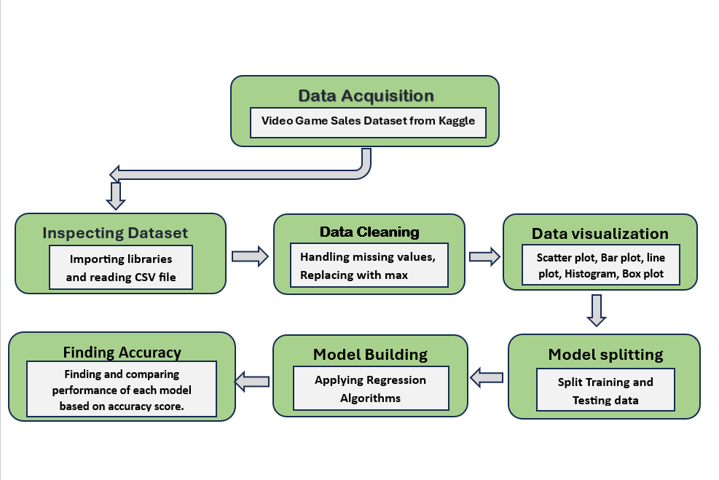
Architecture of vgsales

Slide 6
Data Cleaning & Preprocessing
Data Cleaning : Data cleaning is the process of fixing or removing incorrect, corrupted, incorrectly formatted, duplicate, or incomplete data within a dataset. When combining multiple data sources, there are many opportunities for data to be duplicated or mislabeled.
Data Preprocessing : Data preprocessing is a step in the data mining and data analysis process that takes raw data and transforms it into a format that can be understood and analyzed by computers and machine learning.

Slide 7
Model Building
We have used here Supervised Learning Algorithm.
Supervised Machine Leaning : This type of ML involves supervision, where machines are trained on labelled datasets and enabled to predict outputs based on the provided training.
It is classified into two categories:
1. Classification
2. Regression
We used Regression algorithms in our project.

Slide 8
Algorithm Used in Project
Linear regression: Linear regression is a statistical method that describes the relationship between a dependent variable and one or more independent variables. The dependent variable is the variable that you are trying to predict, and the independent variables are the variables that you are using to make the prediction.
Decision Tree Algorithm : Decision Tree is a supervised learning algorithm which can be used for solving both classification and regression problems.It can solve problems for both categorical and numerical data Decision Tree regression builds a tree-like structure in which each internal node represents the "test" for an attribute, each branch represent the result of the test, and each leaf node represents the final decision or result.
Random Forest Regressor : Random forests are a type of machine-learning algorithm that can be used to predict future sales. They are based on the idea of decision trees, which are a type of predictive modeling algorithm. A decision tree is a tree-like structure that is used to predict an outcome.
K nearest neighbors : KNN is a supervised machine learning algorithm that can be used for classification and regression tasks. In this, we calculate the distance between features of test data points against those of train data points. Then, we take a mode or mean to compute prediction values.

Slide 9
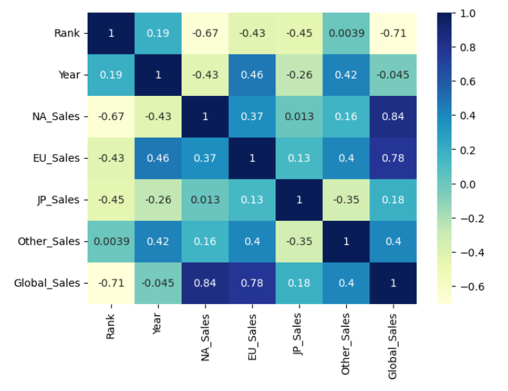
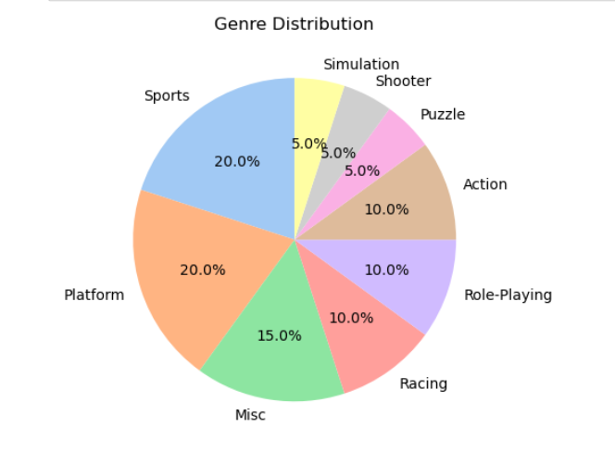
Visualization
Heatmap showing relationships between variables
Piechart of Genre Distribution

Slide 10
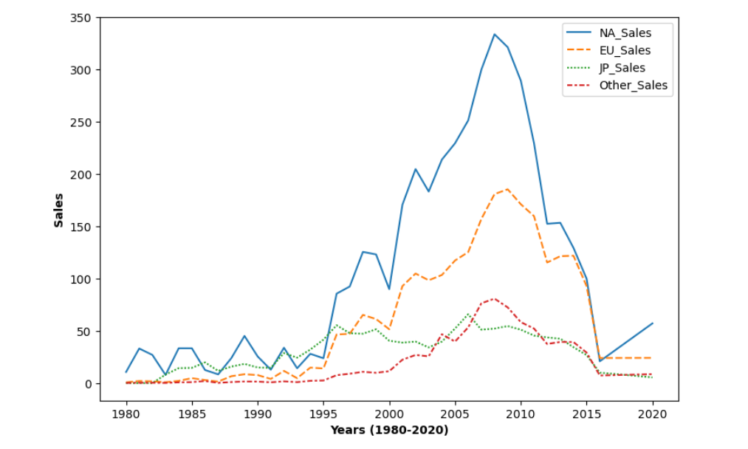
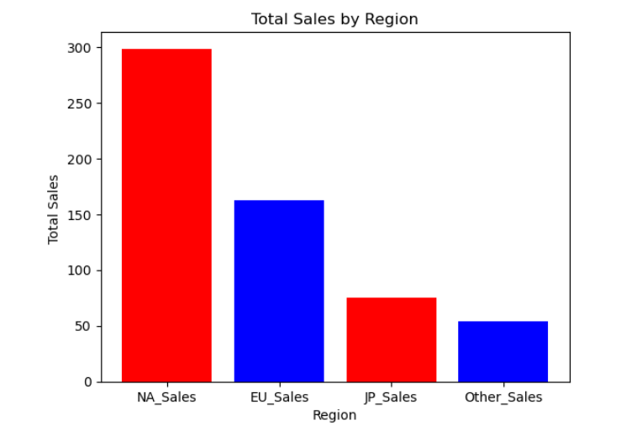
Video Games year-wise sales Vgsales by Region

Slide 11
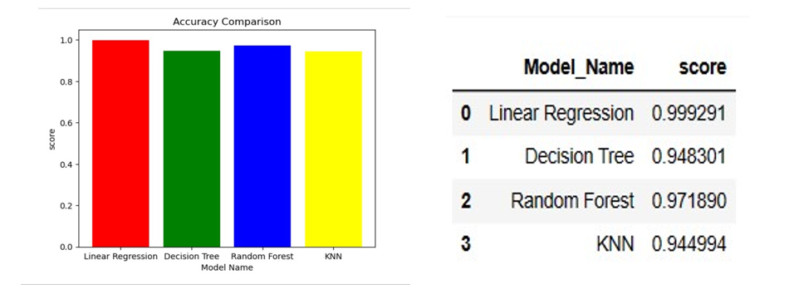
Conclusion
Accuracy is an evaluation metric particularly used for classification tasks. It represents the percentage of accurate predictions. We calculate it as a ratio of the total number of correct predictions to the total number of predictions generated by the model.

Slide 12
Thank you

